Slide 1
Just Another Movie
Project Design

Slide 2
Outline
Frontend
Sketches
Class Diagram
Backend
AI
Database
ERD Diagram
Class Diagram
Class Diagram

Slide 3
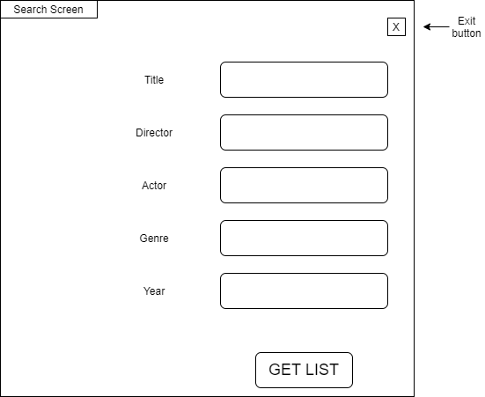
Frontend:Search Screen

Slide 4
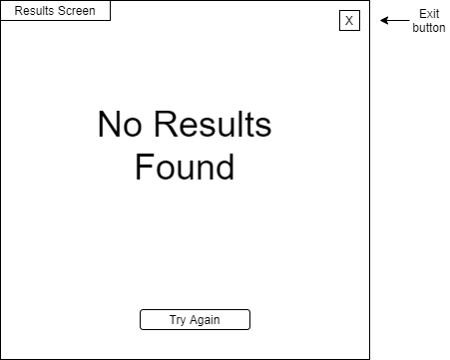
Frontend: Results Screen

Slide 5
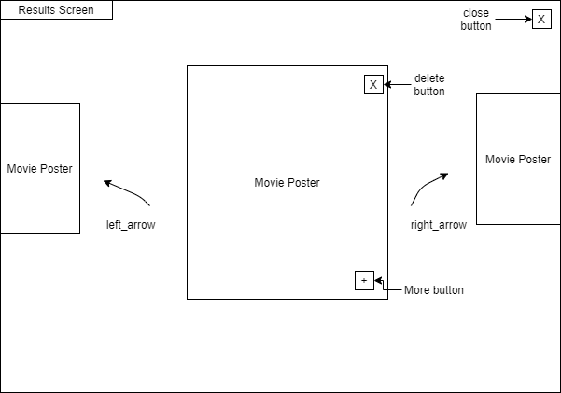
Frontend: Results Screen

Slide 6
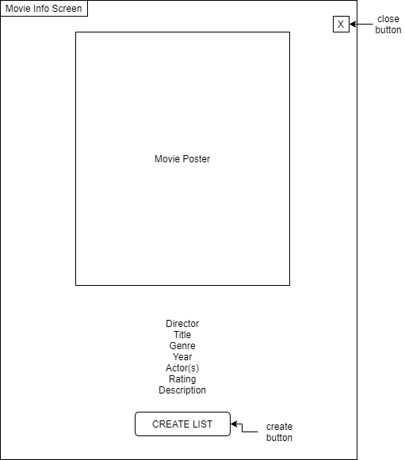
Frontend: Movie Information Screen

Slide 7
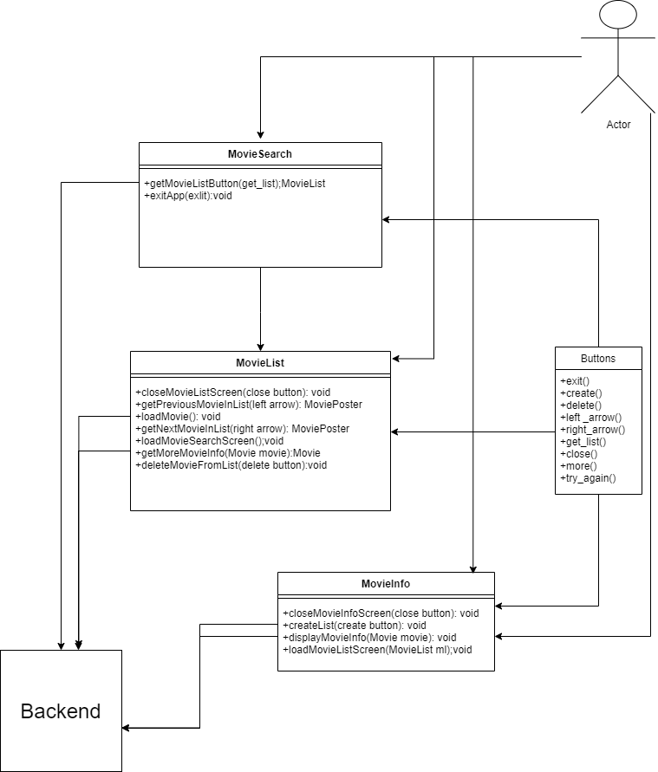
Frontend- Class Diagram

Slide 8
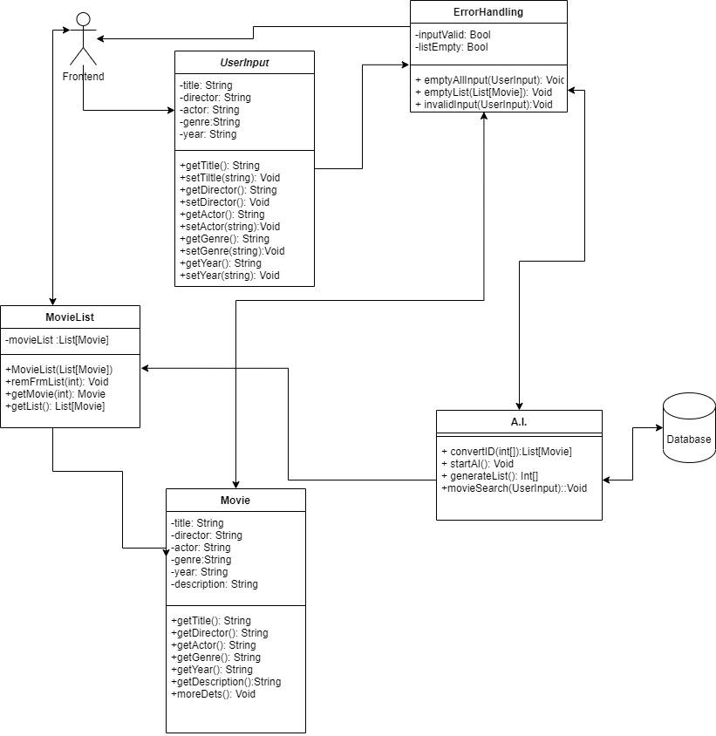
Backend
Class
Diagram

Slide 9
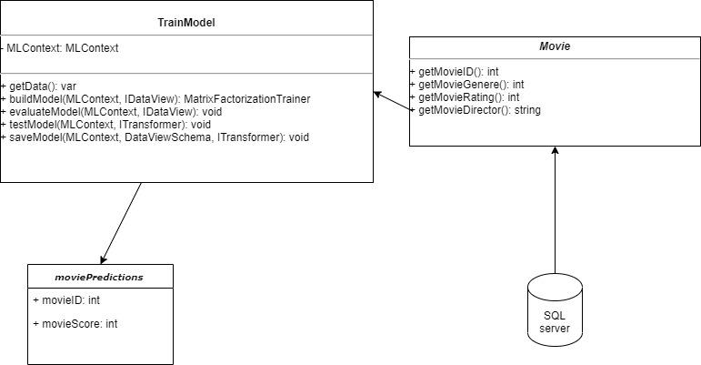
AI

Slide 10
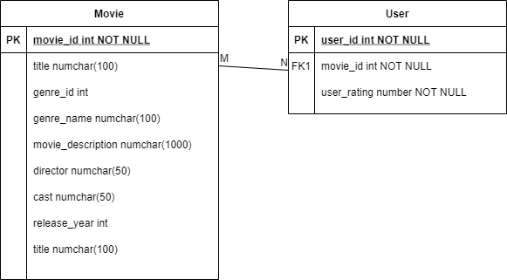
Database

Slide 11
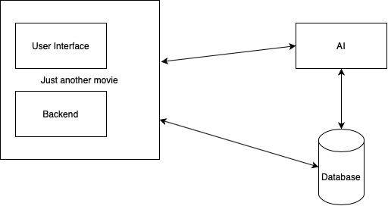
Conclusion

Slide 12

Thanks for Listening

